Slide 1
CSI 202 Skills Lab 5
GU (Foley) Catheterization, Breast, Testicular, Pelvic & Rectal Examinations
Daryl P. Lofaso, Ph.D., M.Ed, RRT

Slide 2
Urethral Catheterization
Indications
Long Term
Refractory bladder outlet obstruction
Neurogenic bladder with urinary retention
Complications of incontinence
Skin breakdown
Terminally ill
Short Term
Urologic or pelvic surgery
Acute urinary retention
Urinary output monitoring in critically ill

Slide 3
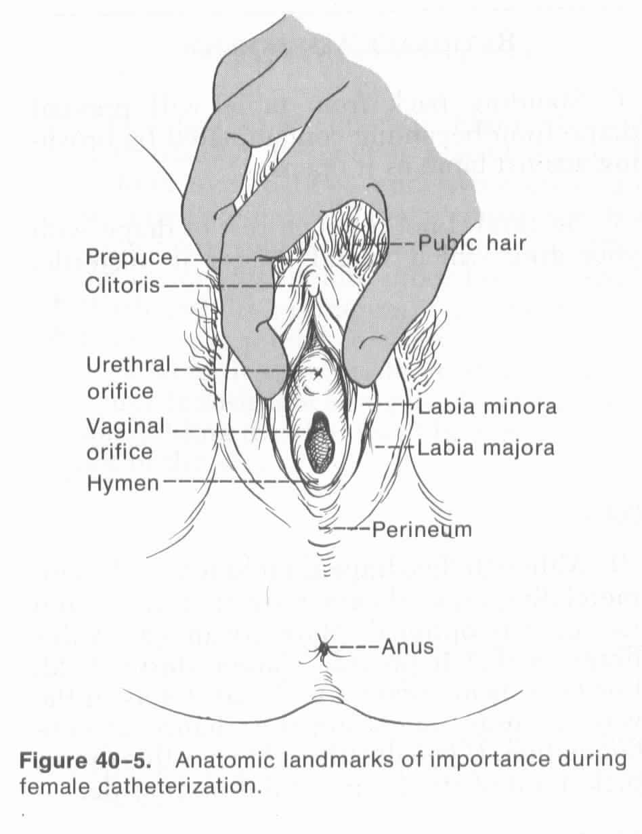
Anatomic Landmark for Female Catheterization

Slide 4
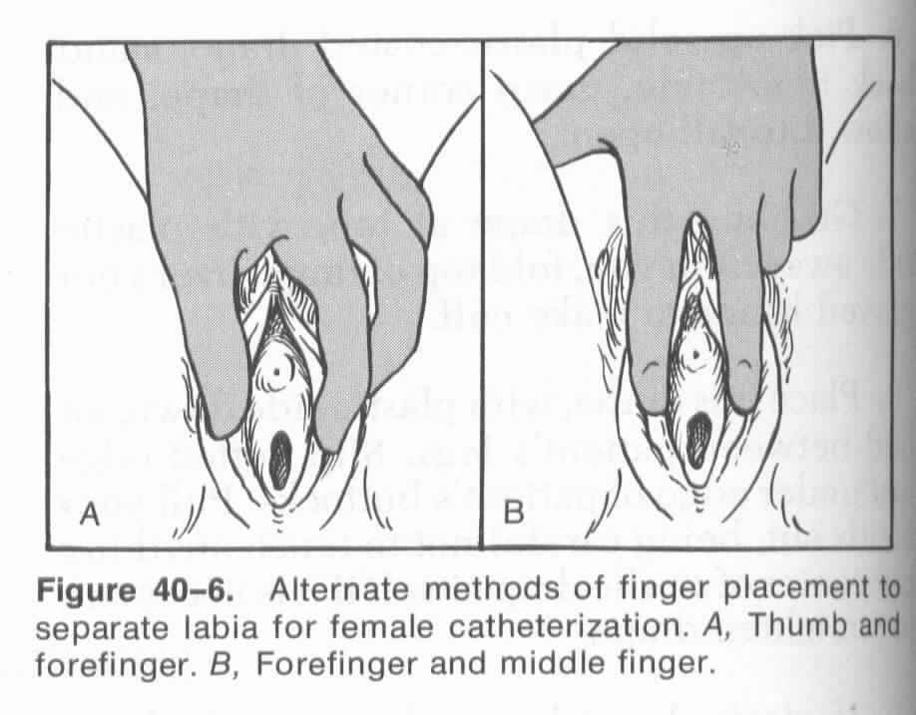
Female Cath: Hand positions

Slide 5
Male Catheterization
Uncircumcised male -pull foreskin back
Visualize the meatus
Maintain hand position throughout procedure

Slide 6
Nosocomial UTI
80% associated w/urinary catheters
Common Organisms
E. coli
Enterococcus species*
Pseudomonas aeruginosa*
Candida albicans
* Antibiotic resistance may lead to increased morbidity

Slide 7
Pelvic Examination
Indications:
Physical Exam
Abdominal pain
Pelvic pain
Yearly screening (pap smear)

Slide 8
Breast Examination
Indications:
Physical Exam
Breast Pain
Lumps
Breast Development- adolescent

Slide 9
Breast CA
NCI recommends mammograms every 1-2 years at 40 yrs. of age
Mammograms yearly at age 50
Mammograms as early as 25 yrs. of age for pt. with high risk of breast CA
Studies suggest Breast CA could be cut by 36-44% if mammography performed annually

Slide 10
Breast CA - Statistics
In 2021
1 in 8 U.S. woman (about 13%) will develop breast cancer over the course of her lifetime.
281,550 women in the US were diagnosed with breast cancer
43,600 women in the US died from breast cancer
2,650 new cases of invasive breast cancer are expected to be diagnosed in men.
https://www.breastcancer.org/symptoms/understand_bc/statistics

Slide 11
Rectal Examination
Indications:
Physical Exam
Abdominal pain
Rectal pain
Urogenital dysfunction (complaints)
Screening for Colon CA and Prostate CA

Slide 12
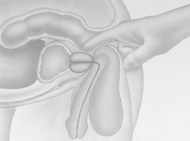
Prostate Examination

Slide 13
Charting: Rectal Examination
Tone – normal, decrease or absent
Masses
Stool color, Hemoccult examination of stool
Prostate – size, texture

Slide 14
Prostate CA
About 1 in 8 diagnosed with prostate cancer during his lifetime.
2nd leading cause of death in American men (1 in 41)
Only 3 men in 100 will actually die of it
Family History - ↑ risk
African American men: very high risk
High fat diet associated with ↑ risk

Slide 15
Testicular Examination
Indications:
Physical Exam
Urologential dysfunction (complaints)

Slide 16
Testicular CA
Incidence of testicular cancer is low, about 1 of every 250 males
Average age: 33 yrs.
Lifetime risk: 1 in 5,000
Testicular Self-examination (TSE)
https://www.cancer.org/cancer/testicular-cancer/about/key-statistics.html

Slide 17
Professional Conduct
Introduce yourself
Explain the procedure/exam to pt.
Ask pt. if they have any questions
Cover pt. with a sheet. Only expose area which you are examining, then cover again
While performing the procedure/exam, explain to the pt., you may or may not be some discomfort associated with the exam, but you will be as gentle as possible.

